Slide 1
GAN
Learning Distribution
GAN model
Objective functions
Application

Slide 2
Generative adversarial network
GAN is a deep neural network architecture comprise of two neural network , competing against the other (i.e. adversarial)
GAN are neural network that are trained in adversarial manner to generate data mimicking some distribution
Two classes are
Discriminator: discriminate between two different classes of data.
Generative model : A generative model G to be trained on training data x sampled from some true distribution D is the one which given some standard random distribution

Slide 3
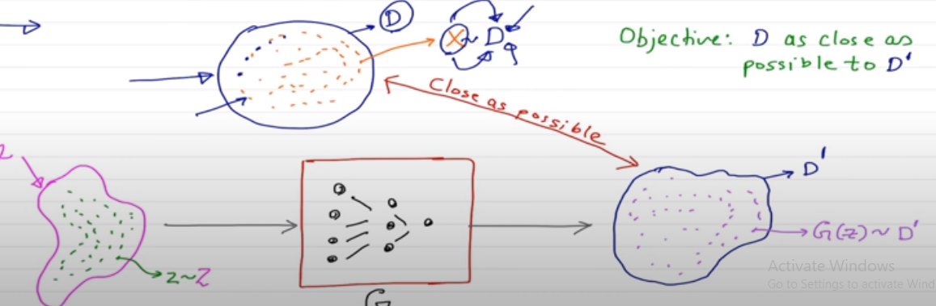
Distribution learning

Slide 4
Learning the distribution
Z produces a distribution D` which is close to D according to some closeness matrix
G(z) ~ D`

Slide 5
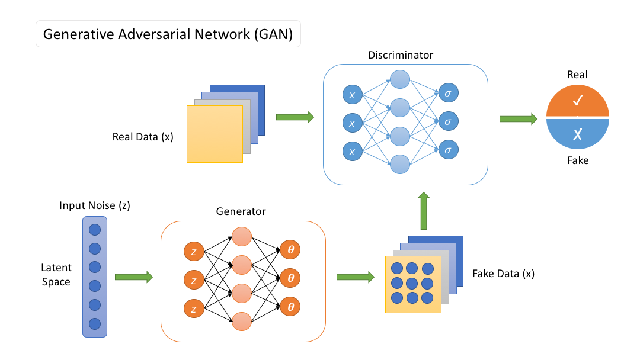
GAN MODEL

Slide 6
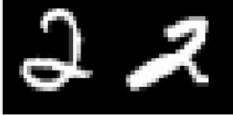
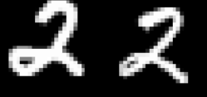

Real or Fake
Discriminator
How do you train such a neural network? Using a two player game
There are two players in the game: a generator and a discriminator
The job of the generator is to produce images which look so natural that the discriminator thinks that the images came from the real data distribution
The job of the discriminator is to get better and better at distinguishing between true images and generated (fake) images
Generator
Real Images
z ∼ N (0, I)
6/38
CS7015 (Deep Learning) : Lecture 23

Slide 7
Let G_{φ} be the generator and D_{θ} be the discriminator (φ and θ are the parameters of G and D, respectively)
We have a neural network based generator which
Real or Fake
Discriminator
takes as input a noise vector z ∼ N (0, I) and produces G_{φ}(z) = X
We have a neural network based discriminator which could take as input a real X or a generated X = G_{φ}(z) and classify the input as real/fake
Generator
Real Images
z ∼ N (0, I)
7/38
CS7015 (Deep Learning) : Lecture 23

Slide 8
Objective function
Real or Fake
Discriminator
Let’s look at the objective function of the generator first
Given an image generated by the generator as G_{φ}(z) the discriminator assigns a score D_{θ} (G_{φ}(z)) to it
This score will be between 0 and 1 and will tell us the probability of the image being real or fake
For a given z, the generator would want to maximize log D_{θ} (G_{φ}(z)) (log likelihood) or minimize log(1 − D_{θ} (G_{φ}(z)))
Generator
Real Images
z ∼ N (0, I)
8/38
CS7015 (Deep Learning) : Lecture 23

Slide 9
This is just for a single z and the generator would like to do this for all possible values of z,
Real or Fake
For example, if z was discrete and drawn from a
1
uniform distribution (i.e., p(z) = ∀z) then the
Discriminator
N
generator’s objective function would be
N
Σ
1
N
min
φ
log(1 − D (G (z)))
θ φ
Generator
Real Images
i=1
However, in our case, z is continuous and not uniform (z ∼ N (0, I)) so the equivalent objective
function would be
ˆ
z ∼ N (0, I)
min p(z) log(1 − D_{θ} (G_{φ}(z)))
φ
min E [log(1 − D (G (z)))]
φ
z∼p(z)
θ φ
9/38
CS7015 (Deep Learning) : Lecture 23

Slide 10
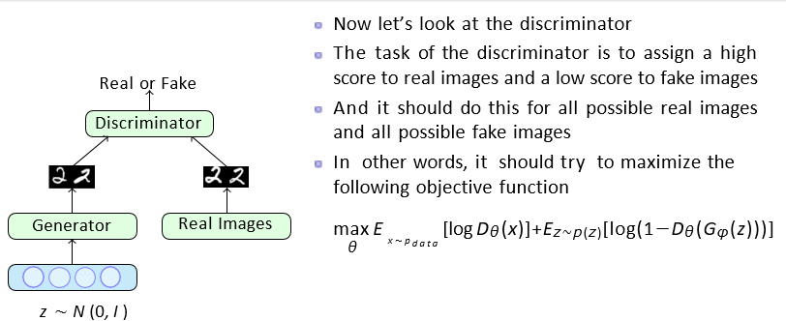

Slide 11
If we put the objectives of the generator and discriminator together we get a minimax game
Real or Fake
min max log D_{θ} (x)
φ θ
[Ex∼p
data
Discriminator
+ E_{z∼p(z)} log(1 − D_{θ} (G_{φ}(z)))]
The first term in the objective is only w.r.t. the parameters of the discriminator (θ)
The second term in the objective is w.r.t. the parameters of the generator (φ) as well as the discriminator (θ)
The discriminator wants to maximize the second term whereas the generator wants to minimize it (hence it is a two-player game)
Generator
Real Images
z ∼ N (0, I)
11/38
CS7015 (Deep Learning) : Lecture 23

Slide 12
So the overall training proceeds by alternating between these two step
Real or Fake
Step 1: Gradient Ascent on Discriminator
Discriminator
max [E log D (x)+E log(1−D (G (z)))]
x∼p θ z∼p(z)
θ φ
θ
data
Step 2: Gradient Descent on Generator
Generator
Real Images
min E_{z∼p(z)} log(1 − D_{θ} (G_{φ}(z)))
φ
In practice, the above generator objective does not work well and we use a slightly modified objective
Let us see why
z ∼ N (0, I)
12/38
CS7015 (Deep Learning) : Lecture 23

Slide 13
When the sample is likely fake, we want to give a feedback to the generator (using gradients
4
log(1 − D(g(x)))
— log(D(g(x)))
However, in this region where D(G(z)) is close to 0, the curve of the loss function is very flat and the gradient would be close to 0
Trick: Instead of minimizing the likelihood of the discriminator being correct, maximize the likelihood of the discriminator being wrong
In effect, the objective remains the same but the gradient signal becomes better
2
Loss
0
−2
−4
0.2 0.4 0.6 0.8
D(G(z))
0
1
13/38
CS7015 (Deep Learning) : Lecture 23

Slide 14
GAN APPLICATION
https://neptune.ai/blog/generative-adversarial-networks-gan-applications

